Slide 1

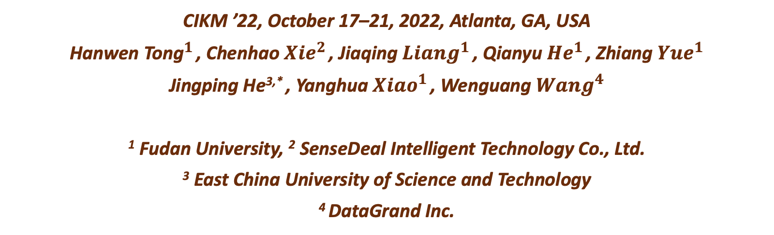
A Context-Enhanced Generate-then-Evaluate Framework for Chinese Abbreviation Prediction
上下文增强
缩略词
CIKM ’22, October 17–21, 2022, Atlanta, GA, USA
Hanwen ${\text{Tong}}^{1}$ , Chenhao ${Xie}^{2}$ , Jiaqing ${Liang}^{1}$ , Qianyu ${He}^{1}$ , Zhiang ${Yue}^{1}$
Jingping He^{3,*} , Yanghua ${Xiao}^{1}$ , Wenguang ${Wang}^{4}$
¹ Fudan University, ² SenseDeal Intelligent Technology Co., Ltd.
³ East China University of Science and Technology
⁴ DataGrand Inc.
Notes:
三个点，单位

Slide 2
Motivation
Methodology
Experiments
Conclusions

Slide 3
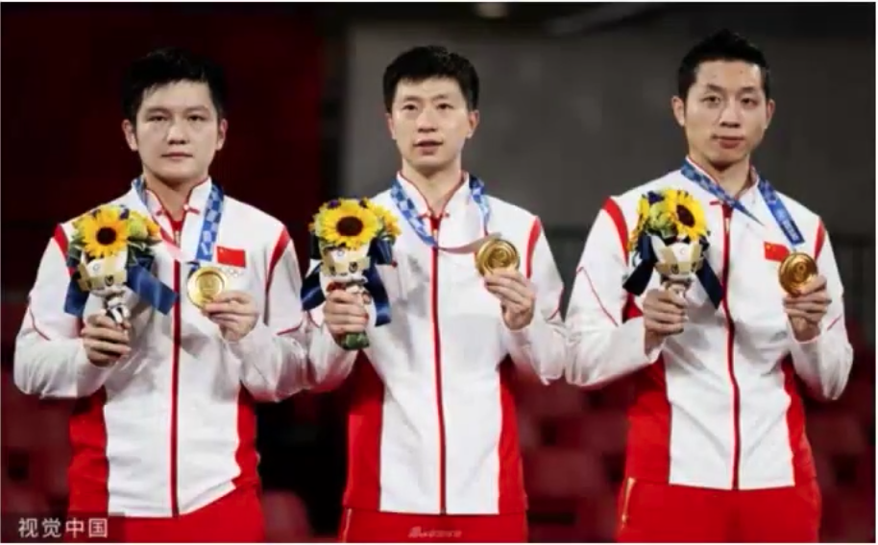
Motivation
Abbreviation are widely used in oral and written language and plays an important role in various NLP applications, especially in Chinese.
“China’s men’s table tennis team won the championship in the Tokyo 2020 Olympics.”
“中国男乒在2020年东京奥运会夺冠”
中国男子乒乓队
奥林匹克运动会
Notes:
缩略词是单词或短语的缩写形式。为了方便写作和表达，在文本中提及某个实体时，人们倾向于使用缩写名称而不是它的完整形式（名称）。理解缩略词，尤其是实体的缩写名称，是知识图谱构建和应用的关键步骤。缩略词处理主要包括三个任务：缩略词扩展，缩略词识别和提取，以及缩略词预测。毫无疑问，缩略词处理在各种自然语言处理 (NLP) 任务中发挥着重要作用例如信息检索、实体链接等任务。 。缩略词实际上是一个子序列，由一个词或一些字符按完整形式的顺序排列。不同于英文缩略词（通常是首字母缩略词），中文缩略词形式更加复杂多样。 象型字，上海交通大学，交通这里的“交通”不是Traffic的交通，而是取“天地交而万物通”之义，因此译作Jiao tong。突出Chinese，背景 国外公信力

Slide 4




Motivation
English
Full Form Major League Baseball
Abbr. MLB
Full Form Association for Computing Machinery
Abbr. MLB
Chinese
Full Form 东南大学
Abbr. 东大
Full Form 复旦大学
Abbr. 复旦
Unlike English, the initial characters of words do not necessarily form a Chinese abbreviation.

Slide 5
Motivation
Most existing approaches formulate Chinese abbreviation prediction as a Sequence Labeling problem
1
0
1
0
1
1
0
0
东 南 大 学
复 旦 大 学
They cannot ensure the predicted abbreviation preserves:
(1)The meaning of the full form
(2)The fluency of the full form
Sequence Labeling models are not good at grasping the overall meaning of the full form.

Slide 6
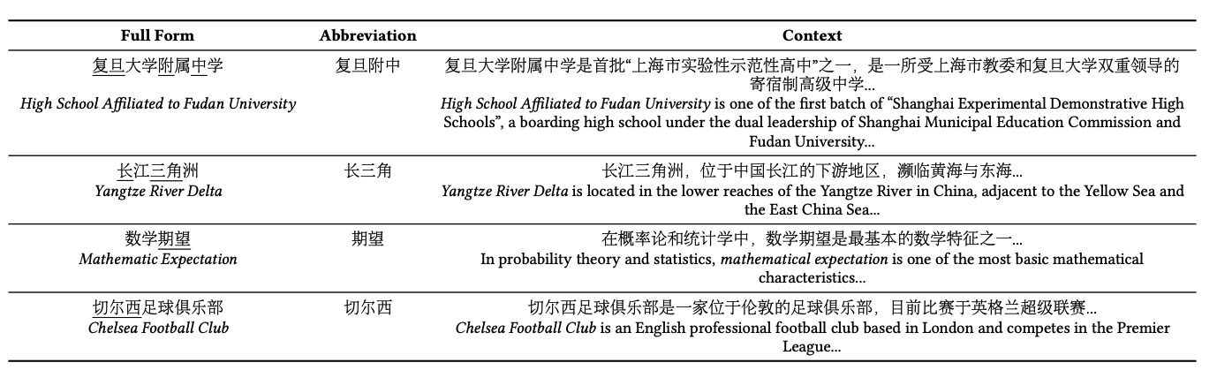
Motivation
An evaluation stage can incorporate external knowledge to evaluate the quality of predicted abbreviations.
Textual contexts contain abundant semantic information, while none of the previous works leverage them.

Slide 7
Motivation
Why contexts help?
A context helps evaluate whether an abbreviation preserves the meaning of the full form.
Full Form
复旦大学附属中学
High School Affiliated to Fudan University
E.g. When replacing “High School Affiliated to Fudan University" with its reasonable abbreviation in context, the meaning of context should remain unchanged.
Context
复旦大学附属中学是首批“上海市实验性示范性高中”之一，是一是一所受上海市教委和复旦大学双重领导的寄宿制高级中学...
High School Affiliated to Fudan University is one of the first batch of “Shanghai Experimental Demonstrative High Schools”, a boarding high school under the dual leadership of Shanghai Municipal Education Commission and Fudan University...
A context helps evaluate the fluency of an abbreviation.
E.g. When replacing “High School Affiliated to Fudan University” with its reasonable abbreviation in context the whole context should be fluent as well.
Notes:
如在上下文中将“复旦大学附属中学”替换为其合理的简称时，上下文的含义应保持不变。
上下文有助于评估缩写的流畅性。

Slide 8
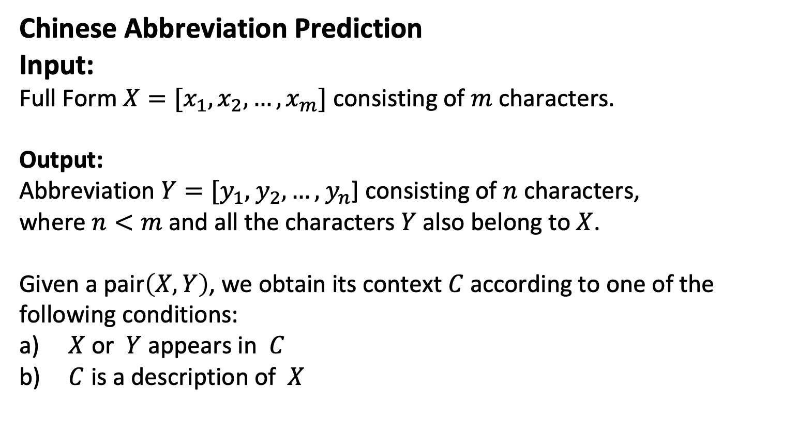
Methodology-Problem Definition
Chinese Abbreviation Prediction
Input:
Full Form $X=[x_{1},x_{2},…,x_{m}]$ consisting of $m$ characters.
Output:
Abbreviation $Y=[y_{1},$ $y_{2},…,$ $y_{n}$] consisting of $n$ characters,
where $n<m$ and all the characters $Y$ also belong to $X$.
Given a pair$\left(X,Y\right)$, we obtain its context $C$ according to one of the following conditions:
$X$ or $Y$ appears in $C$
$C$ is a description of $X$

Slide 9
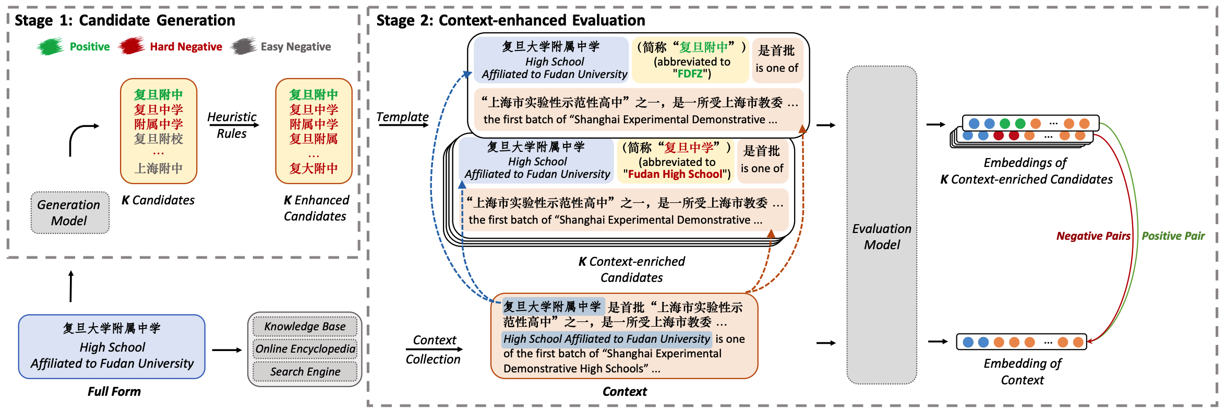
Methodology-Overview
A Two-Stage, Context-Enhanced, Generate-then-Evaluate Framework

Slide 10
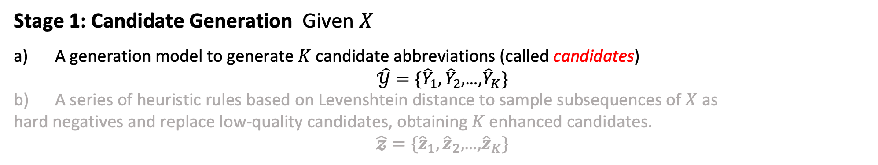
Methodology-Overview
Stage 1: Candidate Generation Given $X$
A generation model to generate $K$ candidate abbreviations (called candidates)
$\hat{𝒴}=\{{\hat{Y}}_{1},{\hat{Y}}_{2},$…,${\hat{Y}}_{K}\}$
b) A series of heuristic rules based on Levenshtein distance to sample subsequences of $X$ as
hard negatives and replace low-quality candidates, obtaining $K$ enhanced candidates.
$\hat{𝔃}=\{{\hat{z}}_{1},{\hat{z}}_{2},$…,${\hat{z}}_{K}\}$

Slide 11
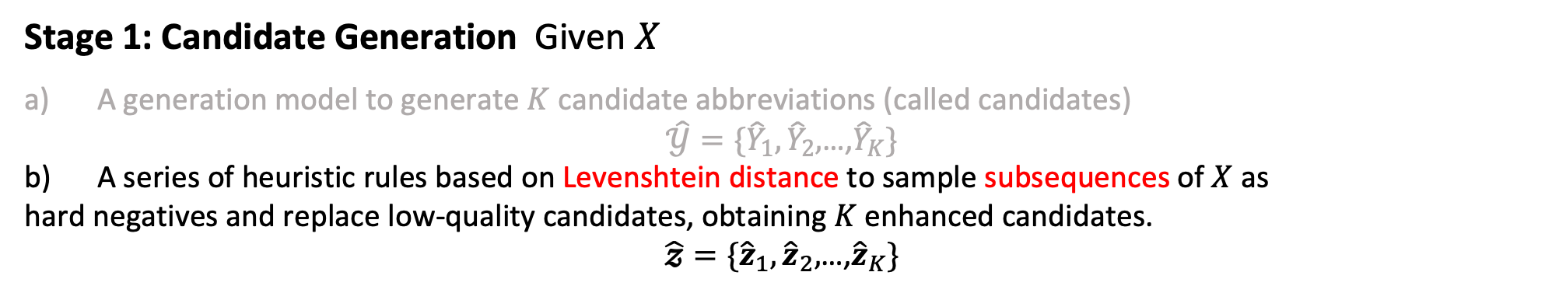
Methodology-Overview
Stage 1: Candidate Generation Given $X$
A generation model to generate $K$ candidate abbreviations (called candidates)
$\hat{𝒴}=\{{\hat{Y}}_{1},{\hat{Y}}_{2},$…,${\hat{Y}}_{K}\}$
b) A series of heuristic rules based on Levenshtein distance to sample subsequences of $X$ as
hard negatives and replace low-quality candidates, obtaining $K$ enhanced candidates.
$\hat{𝔃}=\{{\hat{z}}_{1},{\hat{z}}_{2},$…,${\hat{z}}_{K}\}$

Slide 12
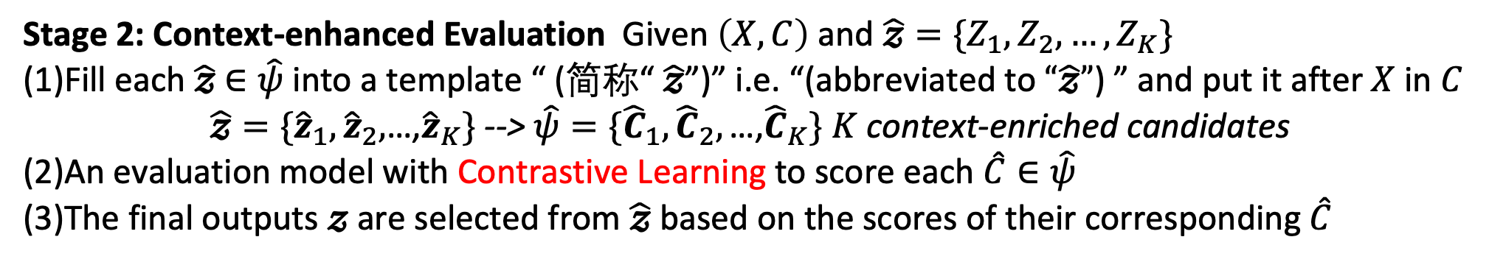
Methodology-Overview
Stage 2: Context-enhanced Evaluation Given $\left(X,C\right)$ and $\hat{𝔃}=\{Z_{1},Z_{2},…,Z_{K}\}$
(1)Fill each $\hat{𝔃}$ $∈\hat{ψ}$ into a template “ (简称“ $\hat{𝔃}$”)” i.e. “(abbreviated to $“\hat{𝔃}”$) ” and put it after $X$ in$C$
$\hat{𝔃}=\{{\hat{z}}_{1},{\hat{z}}_{2},$…,${\hat{z}}_{K}\}$ --> $\hat{ψ}=\{{\hat{C}}_{1},{\hat{C}}_{2},\text{…,}{\hat{C}}_{K}\}$ $K$ context-enriched candidates
(2)An evaluation model with Contrastive Learning to score each $\hat{C}∈\hat{ψ}$
(3)The final outputs $𝔃$are selected from $\hat{𝔃}$ based on the scores of their corresponding $\hat{C}$

Slide 13
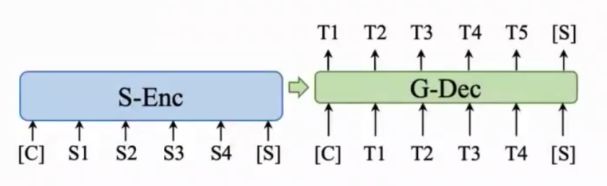
Stage 1: Candidate Generation
Generation Model: CPT(a pre-trained Transformer encoder-decoder)
We first pre-train CPT on Mention2Entity(M2E) Data of CN-DBpedia, where each item of M2E is (entity, mention)
(1) M2E is based on a knowledge graph containing millions of entities. It is large-scale and appropriate for pre-training.
(2) M2E and abbreviation data share some common features:
phrase-level or word-level texts;
the texts of an entity and its mention are highly overlapped and semantically equivalent, just like a full form and its abbreviation
Sequence-to-Sequence Pre-training
For each pair(entity, mention)
Input: the longer one
Output: the shorter one
CPT for candidate generation
Notes:
生成模型:CPT(一种预训练的变压器编码器-解码器)
我们首先在CN-DBpedia的Mention2Entity(M2E)数据上对CPT进行预训练，其中M2E的每一项都是(实体，提及)
(1) M2E是基于包含数百万个实体的知识图。它是大规模的，适合于前期培训。
(2) M2E和缩写数据有一些共同的特征:
短语级或单词级文本；
实体和它的提及的文本高度重叠，语义等同，就像一个完整的形式和它的缩写
序列间预训练
对于每一对(实体、提及)
输入:较长的那个
输出:较短的一个

Slide 14
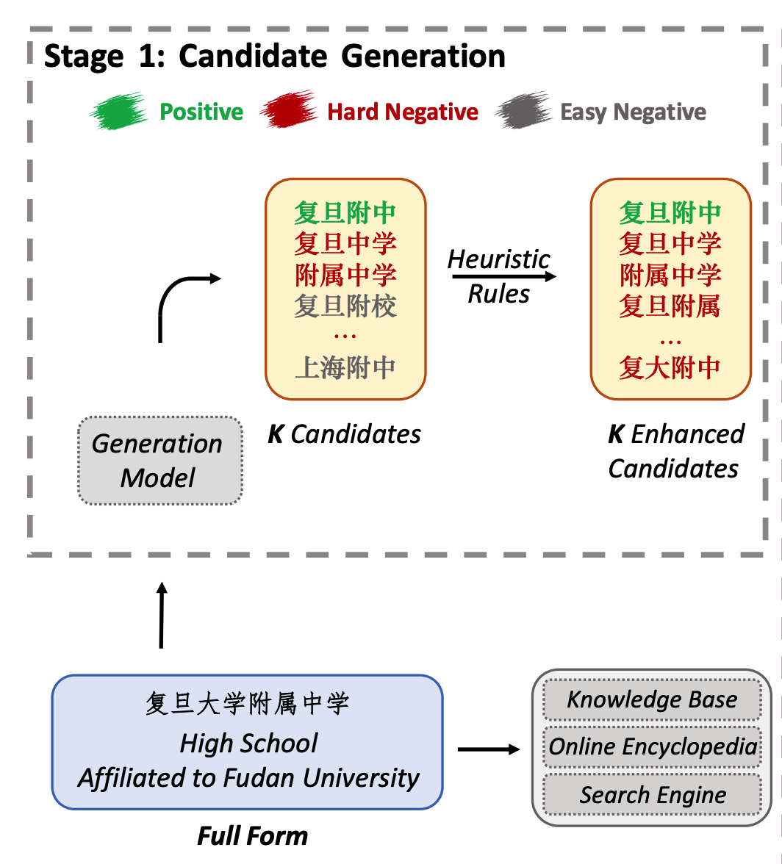
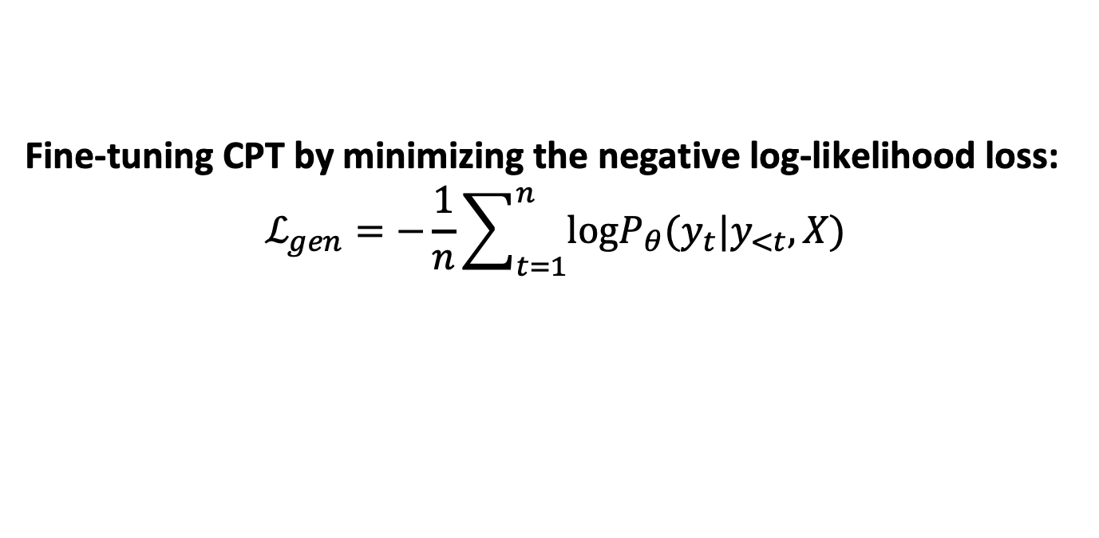
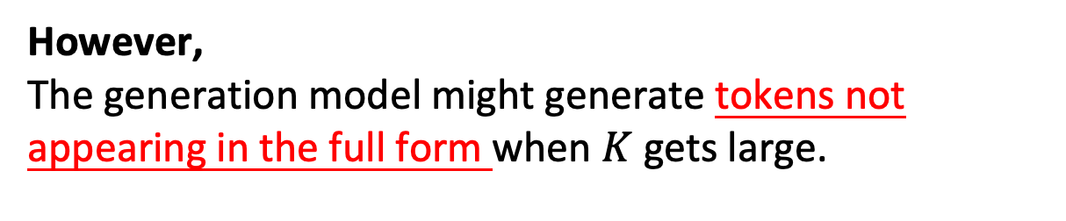
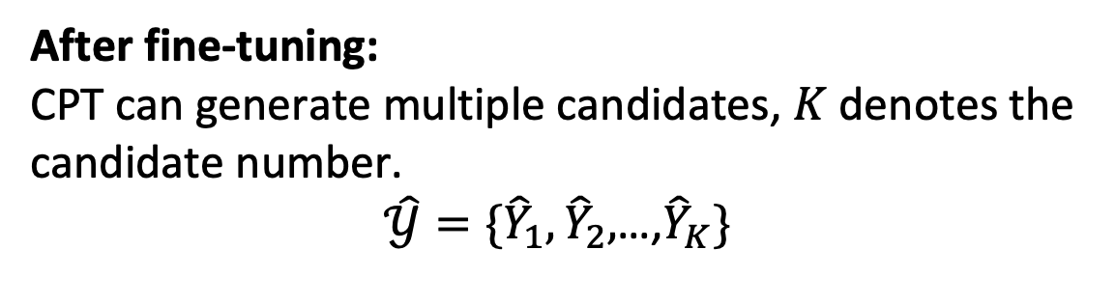
Stage 1: Candidate Generation
Fine-tuning CPT by minimizing the negative log-likelihood loss:
$$ℒ_{gen}=−\frac{1}{n}\sum_{t=1}^{n}{log⁡P_{θ}(y_{t}|y_{<t},X)}$$
After fine-tuning:
CPT can generate multiple candidates, $K$ denotes the candidate number.
$\hat{𝒴}=\{{\hat{Y}}_{1},{\hat{Y}}_{2},$…,${\hat{Y}}_{K}\}$
However,
The generation model might generate tokens not appearing in the full form when $K$ gets large.

Slide 15
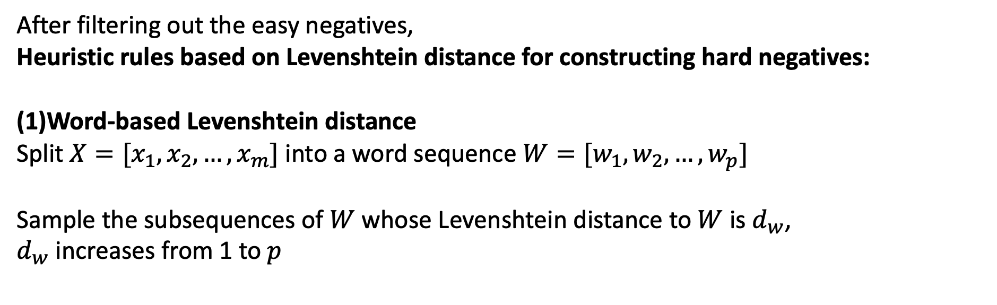
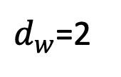


Stage 1: Candidate Generation
After filtering out the easy negatives,
Heuristic rules based on Levenshtein distance for constructing hard negatives:
(1)Word-based Levenshtein distance
Split $X=[x_{1},x_{2},…,x_{m}]$ into a word sequence $W=[w_{1},w_{2},…,w_{p}]$
Sample the subsequences of $W$ whose Levenshtein distance to $W$ is $d_{w}$,
$d_{w}$ increases from 1 to $p$
High School Affiliated to Fudan University
复旦大学附属中学
$$X$$
[复旦，大学，附属，中学]
$$W$$
复旦大学
$d_{w}$=2
Removing a few words from $X$ will keep its readability but make it ambiguous.
Notes:
在过滤掉容易被否定的东西后，
基于Levenshtein距离的启发式规则构造硬否定；
(1)基于单词的Levenshtein距离
将𝑋=[𝑥_1,𝑥_2,…,𝑥_𝑚]拆分成一个单词序列𝑊=[𝑤_1,𝑤_2,…,𝑤_𝑝]
采样𝑊的子序列，其到𝑊的Levenshtein距离是𝑑_𝑤，
𝑑_𝑤从1增加到𝑝

Slide 16
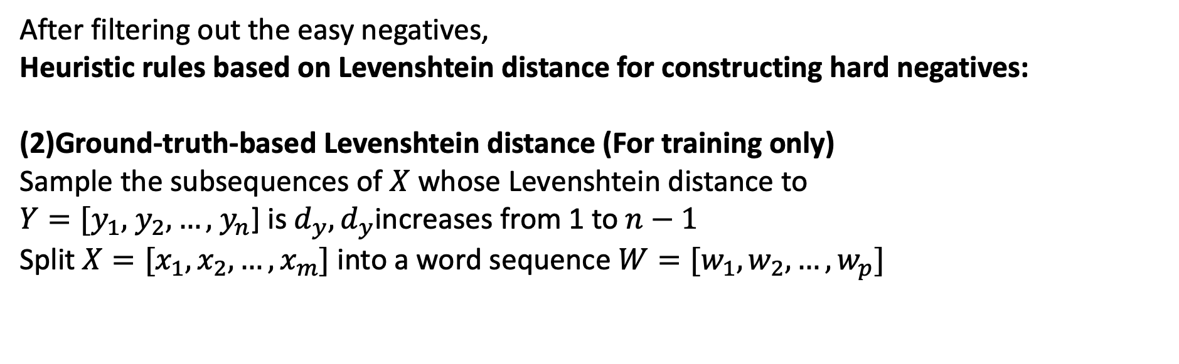


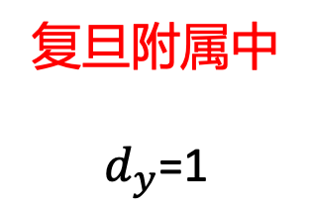
Stage 1: Candidate Generation
After filtering out the easy negatives,
Heuristic rules based on Levenshtein distance for constructing hard negatives:
(2)Ground-truth-based Levenshtein distance (For training only)
Sample the subsequences of $X$ whose Levenshtein distance to
$Y=[y_{1},$ $y_{2},…,$ $y_{n}$] is $d_{y},d_{y}$increases from 1 to $n−1$
Split $X=[x_{1},x_{2},…,x_{m}]$ into a word sequence $W=[w_{1},w_{2},…,w_{p}]$
High School Affiliated to Fudan University
复旦大学附属中学
$$X$$
复旦附属中
$$d_{y}\text{=}\text{1}$$
复旦附中
$$Y$$
Candidates that resemble the ground truth are hard negative examples.

Slide 17
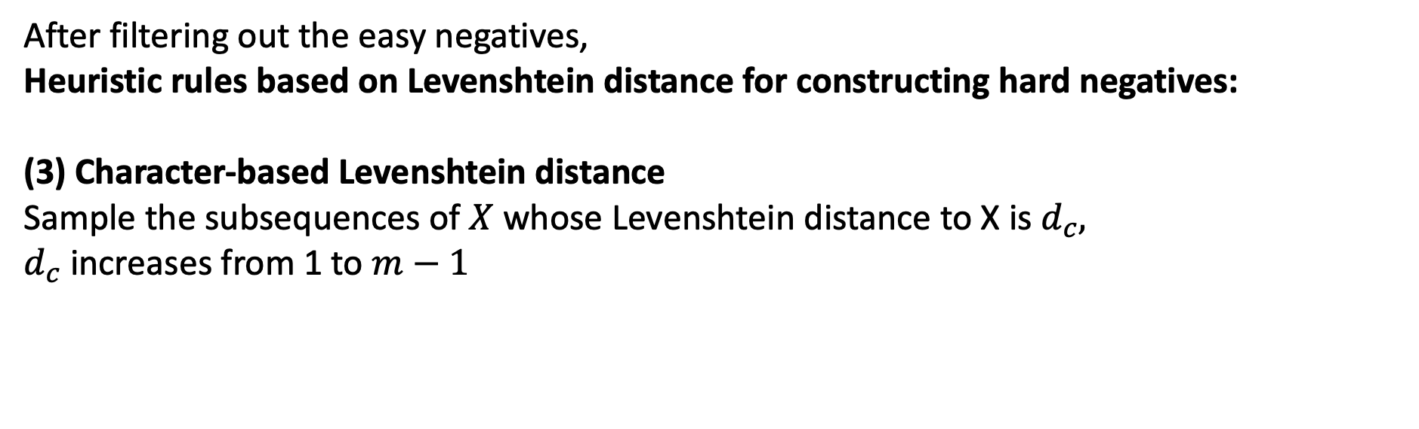


Stage 1: Candidate Generation
After filtering out the easy negatives,
Heuristic rules based on Levenshtein distance for constructing hard negatives:
(3) Character-based Levenshtein distance
Sample the subsequences of $X$ whose Levenshtein distance to X is $d_{c},$
$d_{c}$increases from 1 to $m−1$
$d_{c}$=2
High School Affiliated to Fudan University
复旦大学附属中学
$$X$$
复旦大学附属
Candidates that resemble the full form $X$ might also be the hard negative examples:
they preserve most of the meaning of the full form.

Slide 18

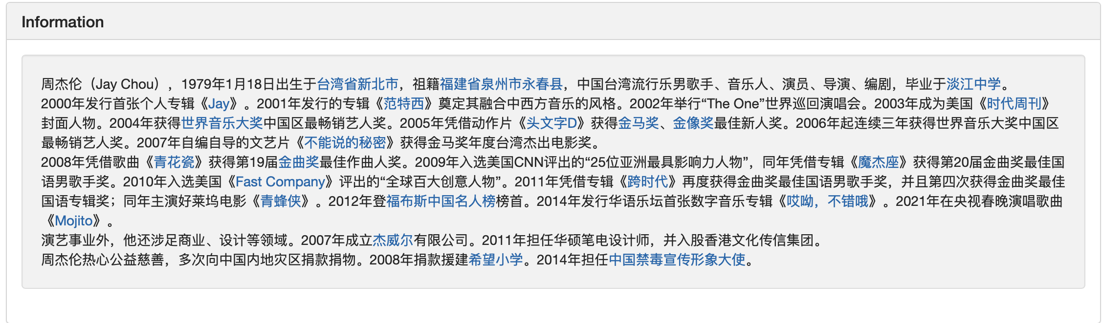

Stage 2: Context-enhanced Evaluation
Context Collection
-Preliminary of framework
Knowledge Base: CN-DBpedia
Online Encyclopedia: Baidu Baike
Search Engine: Google &Baidu
Google
CN-DBpedia
Baidu Baike

Slide 19
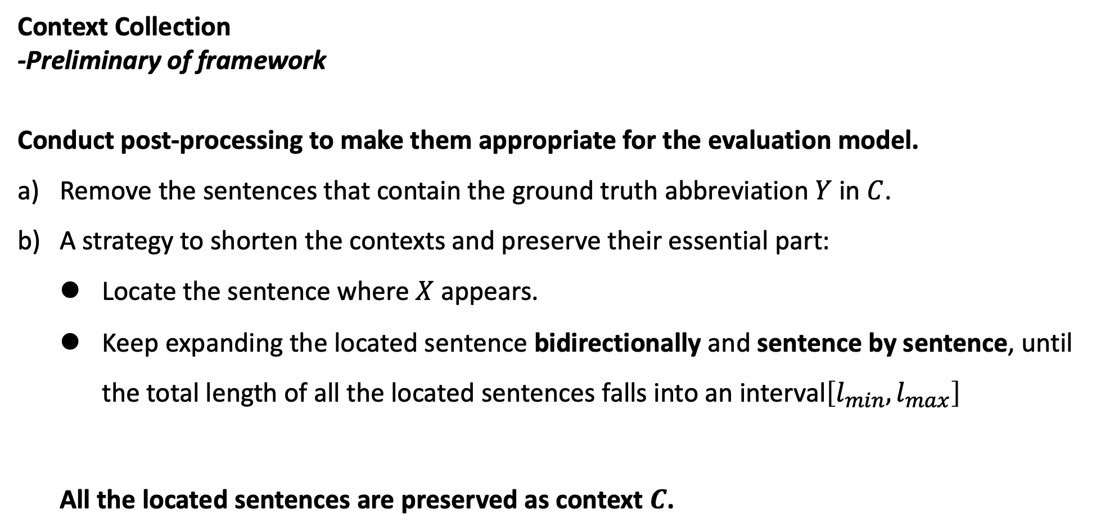
Stage 2: Context-enhanced Evaluation
Context Collection
-Preliminary of framework
Conduct post-processing to make them appropriate for the evaluation model.
Remove the sentences that contain the ground truth abbreviation $Y$ in $C$.
A strategy to shorten the contexts and preserve their essential part:
Locate the sentence where $X$appears.
Keep expanding the located sentence bidirectionally and sentence by sentence, until the total length of all the located sentences falls into an interval$\left[l_{min},l_{max}\right]$
All the located sentences are preserved as context $C$.
Notes:
上下文集合
-初步框架
进行后处理，使其适合评估模型。
删除包含𝐶.地面实况缩写𝑌的句子
缩短上下文并保留其基本部分的策略:
找出𝑋出现的句子。
继续双向逐句扩展定位句子，直到所有定位句子的总长度落入一个interval[𝑙_𝑚𝑖𝑛,𝑙_𝑚𝑎𝑥 ]
所有找到的句子都被保存为上下文𝑪.

Slide 20
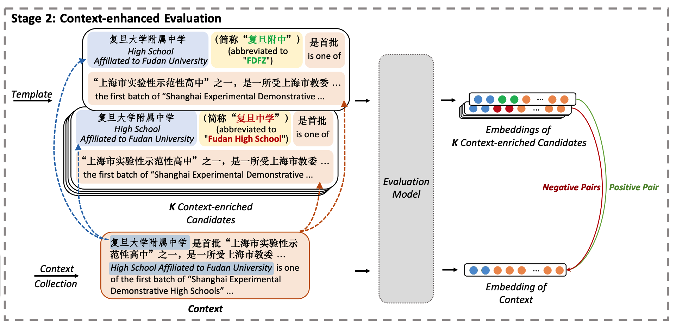
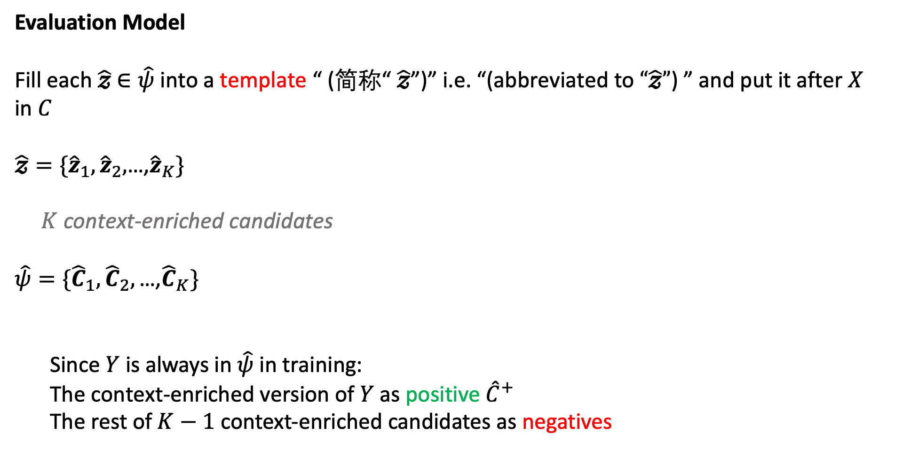
Stage 2: Context-enhanced Evaluation
Evaluation Model
Fill each $\hat{𝔃}$ $∈\hat{ψ}$ into a template “ (简称“ $\hat{𝔃}$”)” i.e. “(abbreviated to $“\hat{𝔃}”$) ” and put it after $X$ in$C$
$\hat{𝔃}=\{{\hat{z}}_{1},{\hat{z}}_{2},$…,${\hat{z}}_{K}\}$
$K$ context-enriched candidates
$\hat{ψ}=\{{\hat{C}}_{1},{\hat{C}}_{2},\text{…,}{\hat{C}}_{K}\}$
Since $Y$ is always in $\hat{ψ}$ in training:
The context-enriched version of $Y$ as positive ${\hat{C}}^{+}$
The rest of $K−1$ context-enriched candidates as negatives

Slide 21
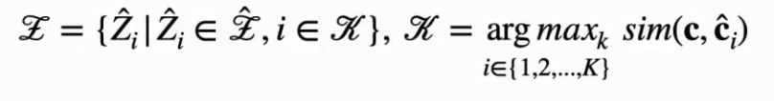

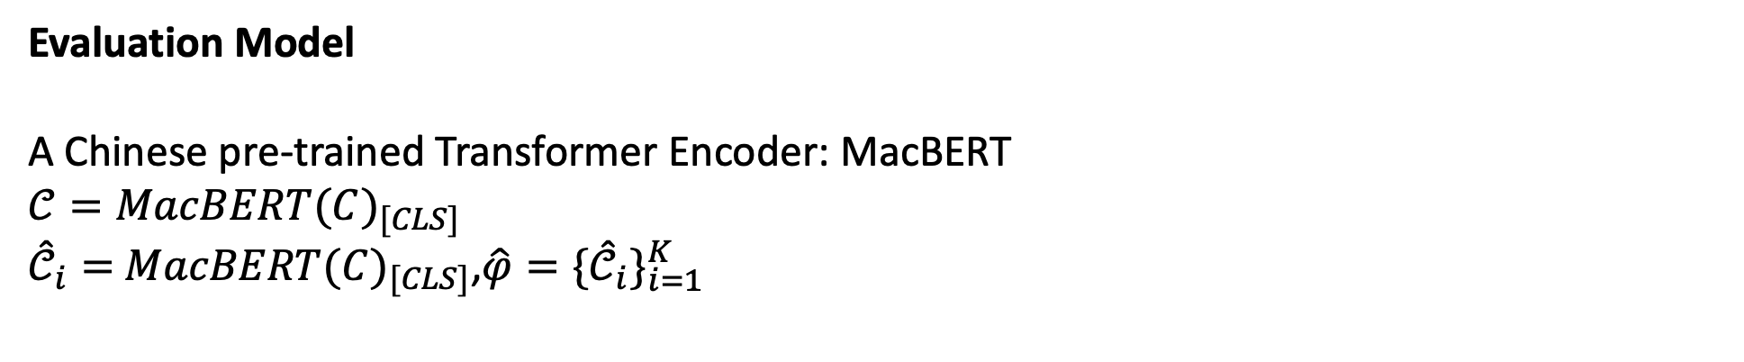
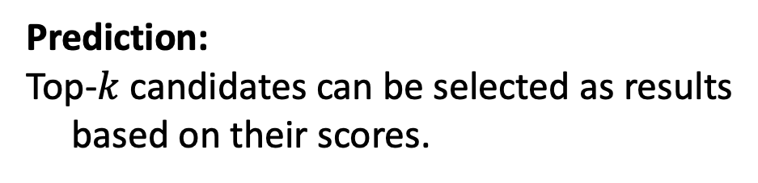
Stage 2: Context-enhanced Evaluation
Evaluation Model
A Chinese pre-trained Transformer Encoder: MacBERT
$$𝒞={MacBERT(C)}_{[CLS]}$$
${\hat{𝒞}}_{i}=$ ${MacBERT(C)}_{[CLS]}$,$\hat{φ}={\{{\hat{𝒞}}_{i}\}}_{i=1}^{K}$
Contrastive Loss:
Prediction:
Top-$k$ candidates can be selected as results
based on their scores.
Notes:
为什么要用BERT 或者 为什么要用模版？

Slide 22
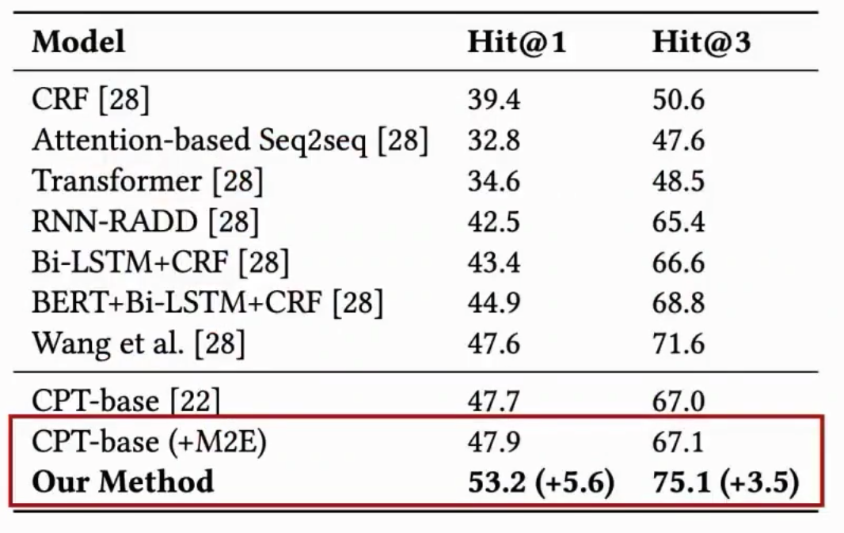
Experiments
Overall Performance
A 5.6 and 3.5 points improvement on Hit@1 and Hit@3 over previous best results respectively.
Pre-training CPT-base on Mention2Entity data is effective.
With the context-enhanced evaluation stage, the performance improves significantly demonstrating the effectiveness of the evaluation stage.
(+M2E) means pre-training on Mention2Entity Data

Slide 23
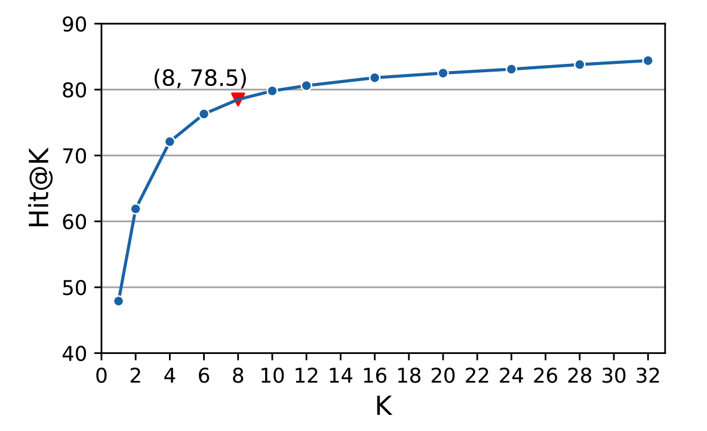
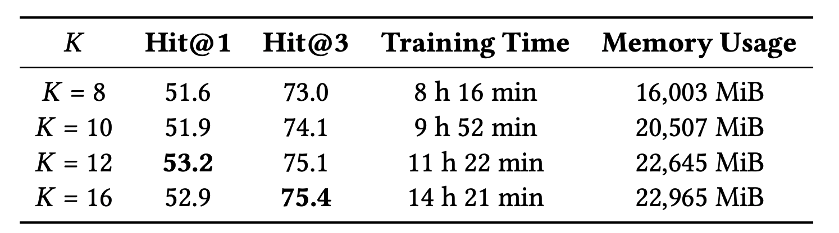
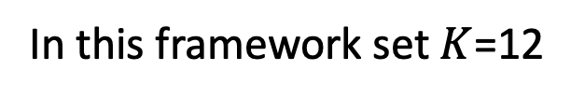
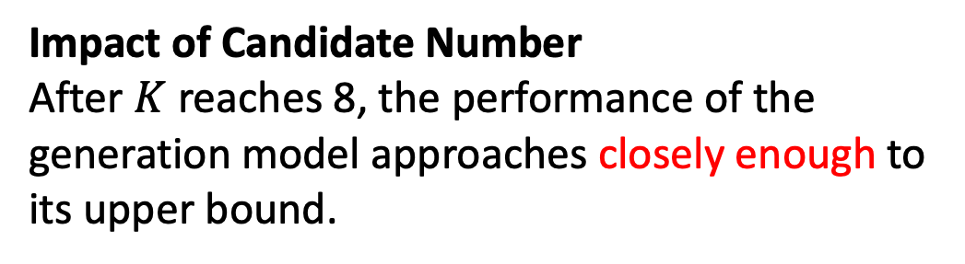
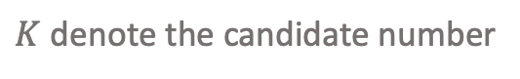
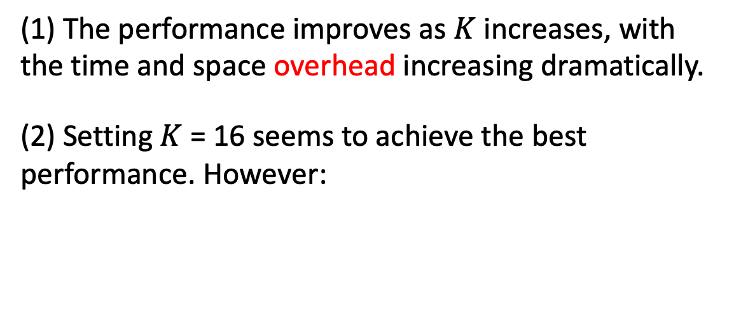
Experiments
Impact of Candidate Number
After $K$ reaches 8, the performance of the
generation model approaches closely enough to its upper bound.
(1) The performance improves as $K$ increases, with the time and space overhead increasing dramatically.
(2) Setting $K$ = 16 seems to achieve the best performance. However:
Performance gain by increasing K becomes marginal
the time and space overhead is significant
out-of-memory problem occurs in the following experiments
$K$ denote the candidate number
In this framework set $K$=12

Slide 24
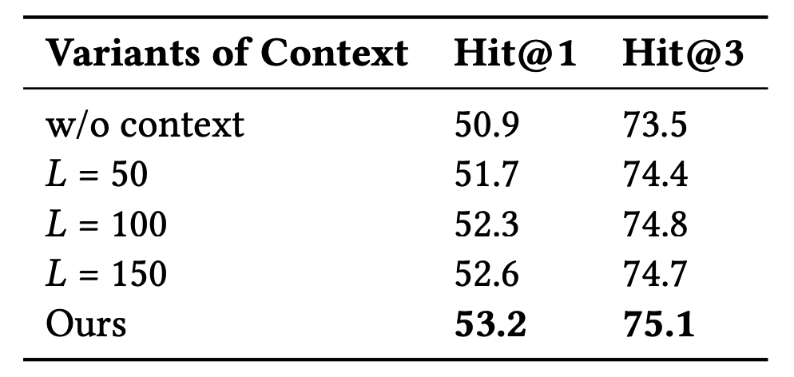
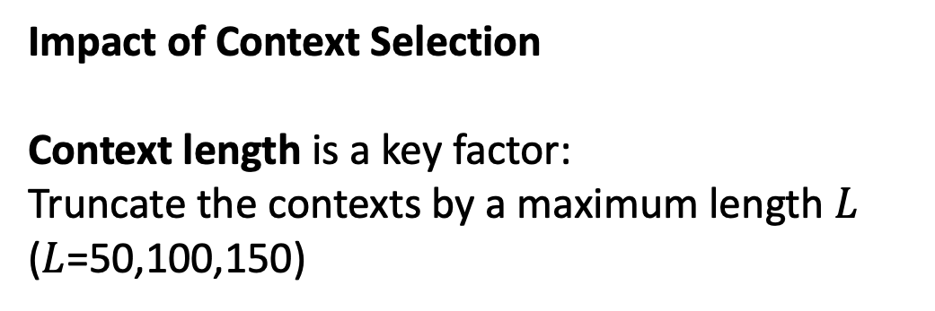
Experiments
Impact of Context Selection
Context length is a key factor:
Truncate the contexts by a maximum length $L$
($L$=50,100,150)
Proves that contexts that are highly relevant to the full form contribute most to performance improvement.
(2) Hit@3 remains relatively stable. The stability shows that our method is robust to different contexts
(3) For the edge case (w/o context)
a) Removing contextual information causes a sign ificant performance collapse
b) Still outperforms all the baselines, showing the effectiveness of the evaluation model

Slide 25
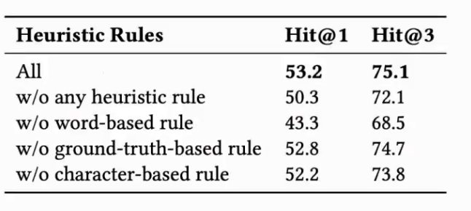
Experiments
Ablation Study
To study the impact of different heuristic rules:
(1) Removing all the heuristic rules leads to a sharp performance drop.
The negative examples constructed by our heuristic rules are essential for performance improvement.
(2)Removing any heuristic rule leads to a performance drop.
Any heuristic rule is necessary and combining them is the optimal decision.
(3) Removing the word-based rule leads to the most significant performance drop
The word-based rule constructs the hardest negative examples
Notes:
启发式规则:

Slide 26
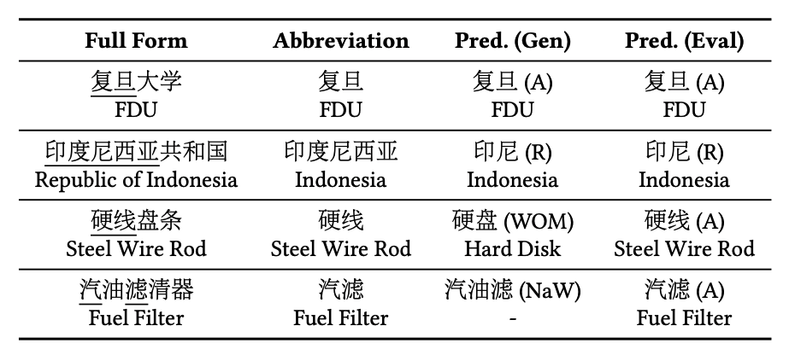
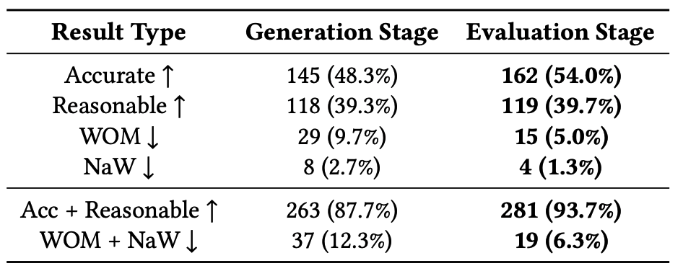
Experiments
Human Evaluation
Each prediction can be categorized into one of the four result types:
(1) Accurate(A)
The prediction is identical to the ground truth
(2) Reasonable(R)
Although the prediction is inconsistent with the ground truth, it is still a correct abbreviation
(3) A word but other meanings (WOM)
The prediction is a word but does not preserve the meaning of its full form
(4) Not a word (NaW)
The prediction is meaningless
The predictions of our framework are mostly decent and reasonable abbreviations.
“Pred.(Gen)” denotes the prediction of the generation stage; “Pred. (Eval)” denotes the prediction of the evaluation stage.
A higher ratio of the Accurate and Reasonable types indicates a better performance.
Notes:
人类评估
每个预测都可以归类为四种结果类型之一:
(1)准确(A)
这一预测与事实是一致的
(2)合理的
虽然预测与地面事实不符，但仍是正确的缩写
③一个词却有其他含义(WOM)
预测是一个单词，但并不保留其完整形式的含义
(4)一个字也没有
这个预测毫无意义
我们框架的预测大多是体面合理的缩写。

Slide 27
Conclusions
Introduce a fresh perspective to evaluate the quality of abbreviations within their textual contexts with pre-trained language model.
(1)Formulate Chinese abbreviation prediction as a generate-then-evaluate
problem and propose a context-enhanced generate-then-evaluate framework.
(2)Implement the framework with a generation model to generate multiple
candidate abbreviations and an evaluation model to evaluate their quality within
their contexts.
Besides, we develop a series of heuristic rules for constructing hard negatives
(3)Experimental results show that our framework significantly outperforms the
state-of-the-art approaches
Notes:
引入一个全新的视角，通过预先训练的语言模型来评估缩略语在文本环境中的质量。
(1)将中文缩写预测公式化为生成-然后评估
问题，并提出一个上下文增强的生成-评估框架。
(2)用生成模型实现框架，以生成多个
候选缩写和评估其质量的评估模型
他们的背景。
此外，我们发展了一系列启发式规则来建构硬否定
(3)实验结果表明，我们的框架明显优于
最先进的方法

Slide 28
谢谢聆听！
lianzhengyang@seu.edu.cn💬

